Slide 1

Which factors affect house energy efficiency?
OBYG
DongHyuk_Kim/ SeungHwan_Kim/ YuJeong_Lee/ Hyerin_Kim

Slide 2

Index
01
02
03
04
Background of Project
Description of Data
Analysis
Conclusion
Q & A

Slide 3
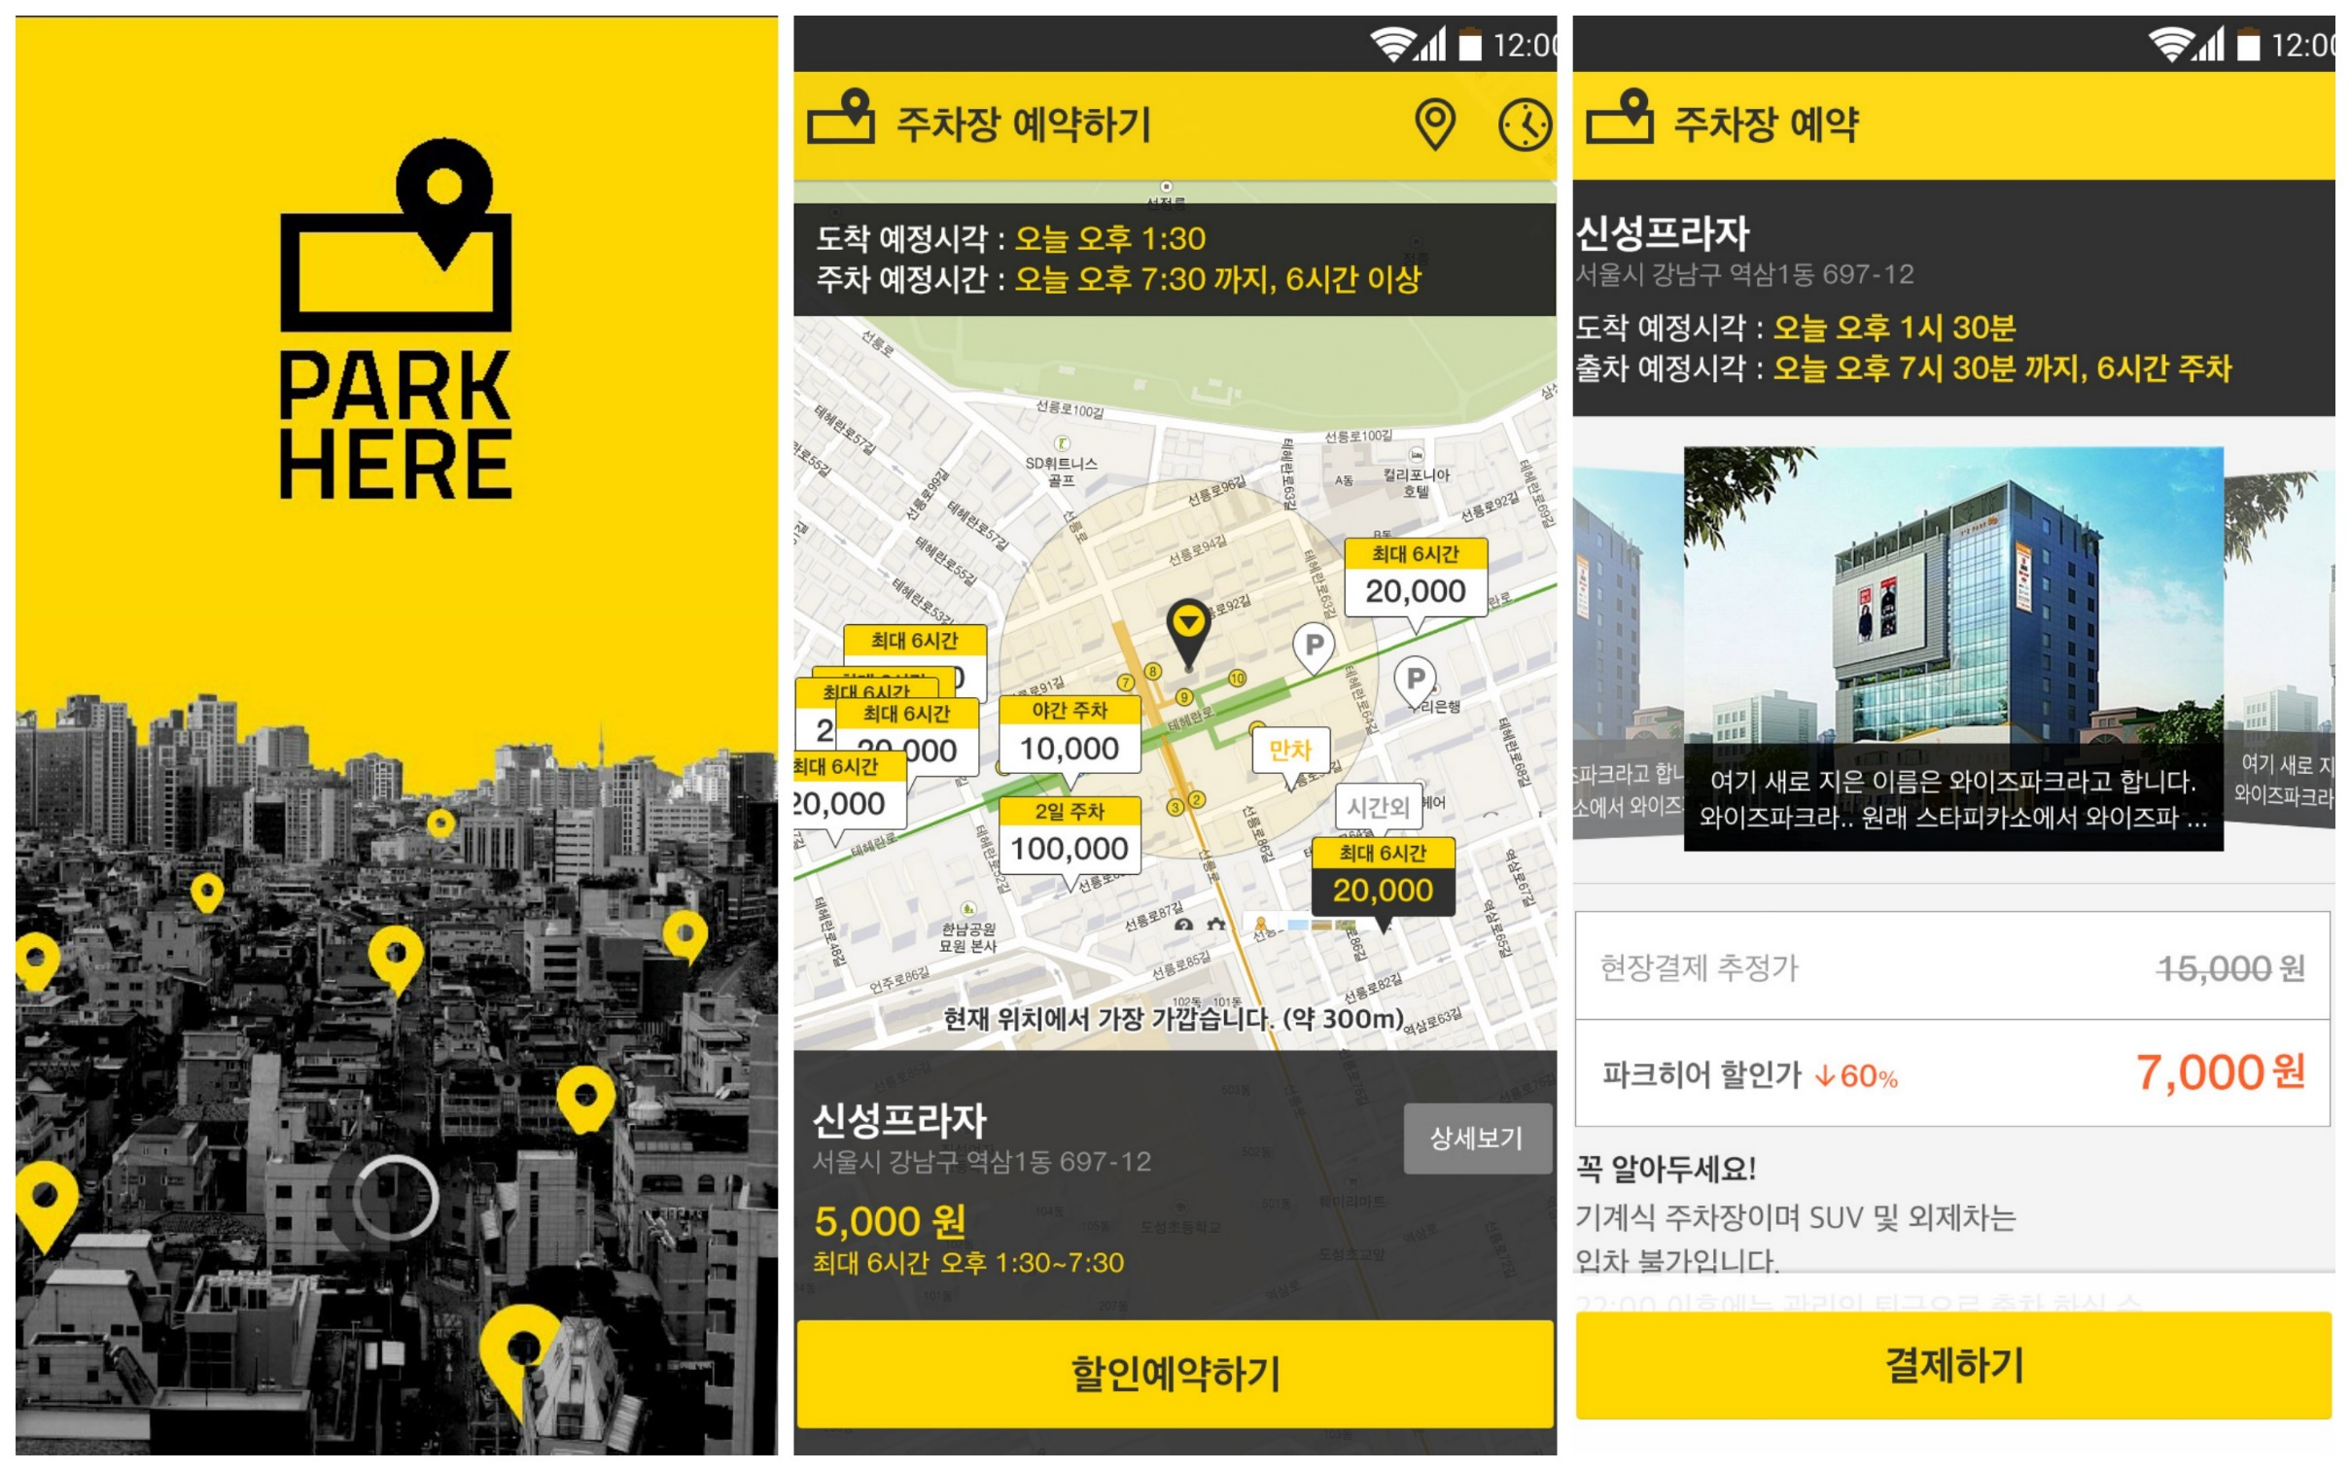
01
Background of Project

Slide 4


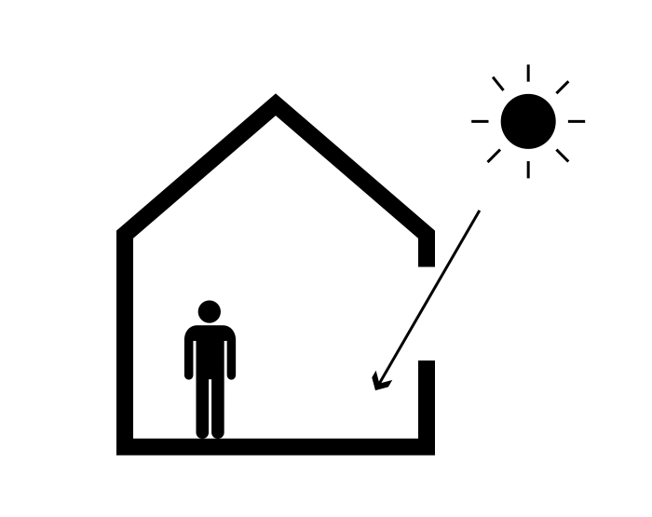



문제1
Research Question
Which factors affect house energy efficiency?

Slide 5





Thermal Load
: the amount of energy needed to be added or removed
from a space to keep occupants comfortable
roof
window
wall
floor

Slide 6

Data Used
: house structure dataset
Explanatory Variable | X1 | Relative Compactness | 12 types of value
 | X2 | Surface Area | 12 types of value
 | X3 | Wall Area | 7 types of value
 | X4 | Roof Area | 4 types of value
 | X5 | Overall Height | 2 types of value
 | X6 | Orientation | 5 types of value
 | X7 | Glazing area | 4 types of value
 | X8 | Glazing area distribution | 6 types of value
Response Variable | Y1 | Heating Load
 | Y2 | Cooling Load
1 uniform
2 North
3 East
4 South
5 West
768 observations

Slide 7
02
Description of Data

Slide 8
The feature of dataset
Table 1. descriptive statistics of dataset
 | X1 | X2 | X3 | X4 | Y1 | Y2
Median | 0.75 | 673.75 | 318.5 | 183.75 | 18.95 | 22.08
Max | 0.98 | 808.5 | 416.5 | 220.5 | 43.1 | 48.03
Min | 0.62 | 514.5 | 245 | 110.25 | 6.01 | 10.9
Mean | 0.764167 | 671.7083 | 318.5 | 176.6042 | 22.3072 | 24.58776
SD | 0.105777 | 88.08612 | 43.62648 | 45.16595 | 10.0902 | 9.513306

Slide 9
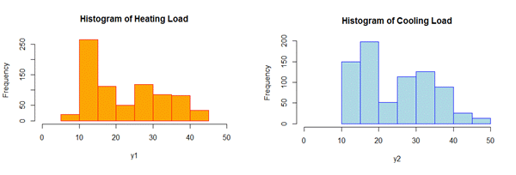
Response Variables
Figure 1. The distribution of the core features

Slide 10
03
Analysis

Slide 11
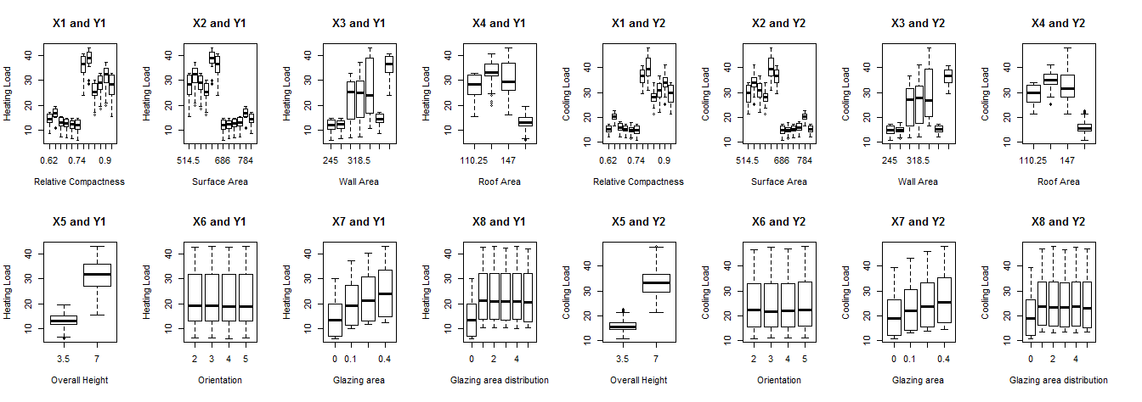
01
The Boxplot of dataset
Figure 2. Boxplot
Little Influence
01

Slide 12
02
Correlation Coefficient
Table 2. Calculated Correlation Coefficient
 | X1 | X2 | X3 | X4 | X5 | X6 | X7 | X8
Y1 | 0.622 | -0.658 | 0.455 | -0.861 | 0.895 | -0.002 | 0.269 | 0.087
Y2 | 0.634 | -0.672 | 0.427 | -0.862 | 0.895 | 0.014 | 0.207 | 0.050
02

Slide 13
03
Multiple Regression Analysis
Model 1.
03
Model 2.

Slide 14
03
Multiple Regression Analysis
Table 3. Estimation Result of Model 1
 | Estimated | Std | t-Value | Pr(>|t|)
Intercept | 84.38757 | 19.11175 | 4.415 | 1.15E-05 | ***
X1 | -64.774 | 10.33361 | -6.268 | 6.11E-10 | ***
X2 | -0.08729 | 0.017149 | -5.09 | 4.51E-07 | ***
X3 | 0.060813 | 0.006676 | 9.109 | < 2e-16 | ***
X5 | 4.169939 | 0.339441 | 12.285 | < 2e-16 | ***
X7 | 20.4379 | 0.798726 | 25.588 | < 2e-16 | ***
Multiple R-squared : 0.9153, Adjusted R-squared : 0.9147, F-statistic: 1646 on 5 and 762 DF, p-value: < 2.2e-16
03

Slide 15
03
Multiple Regression Analysis
Table 4. Estimation Result of Model 2
 | Estimated | Std | t-Value | Pr(>|t|)
Intercept | 97.76185 | 20.75634 | 4.71 | 2.94E-06 | ***
X1 | -70.7877 | 11.22282 | -6.307 | 4.80E-10 | ***
X2 | -0.08825 | 0.018624 | -4.738 | 2.57E-06 | ***
X3 | 0.044682 | 0.007251 | 6.162 | 1.16E-09 | ***
X5 | 4.283843 | 0.36865 | 11.62 | < 2e-16 | ***
X7 | 14.81797 | 0.867458 | 17.082 | < 2e-16 | ***
Multiple R-squared : 0.8876, Adjusted R-squared : 0.8868, F-statistic : 1203 on 5 and 762 DF, p-value : < 2.2e-16
03

Slide 16

04
Conclusion
Notes:
길 위에서 헤매는 당신을 위한 앱

Slide 17


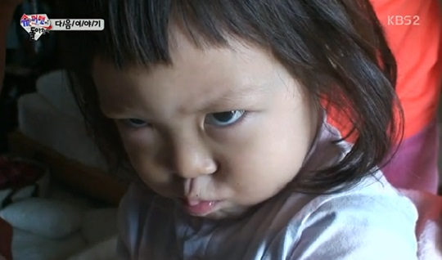

Surface Area(X2)
Wall Area(X3)
Overall Height(X5)
Glazing Area(X7)

Slide 18
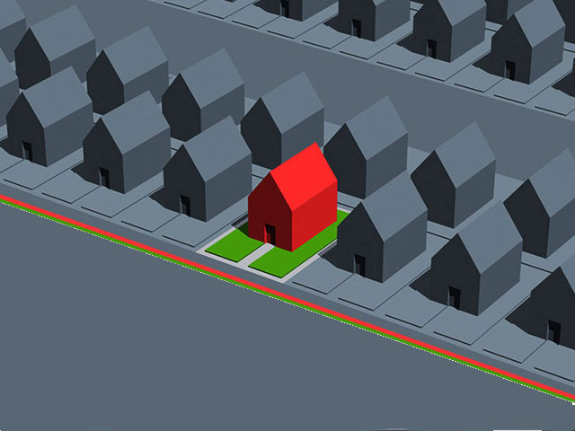

Relative Compactness(X1)
Glazing Area(X7)
Overall Height(X5)
Surface Area(X2)
Wall Area(X3)
Selecting House

Slide 19
References
1) The Building Sustainability Index (BASIX), New Sounth Wales Goverment, http://www.basix.nsw.gov.au
2) Effect Analysis on the Thermal Load by Balcony of Apartment House(2000), Yong-seung Park, Eun-taek Lee, Hee-ghi Hong
3) Heating, ventilating, and air conditioning: analysis and design(1982), FC McQuiston, JD Parker. osti.gov
4) Cooling load prediction for buildings using general regression neural networks, AE Ben-Nakhi(2004), MA Mahmoud
5) Energy Conversion and Management(2004), Elsevier
6) Accurate quantitative estimation of energy performance of residential buildings using statistical machine learning tools(2012), Athanasios Tsanas, Angeliki Xifara
7) Impact of building shape on thermal performance of office buildings in Kuwait(2009), Adnan AlAnzi, et al.
8) Impact of shape on building energy use in Tunisia(2006), Kais Ouertani

Slide 20
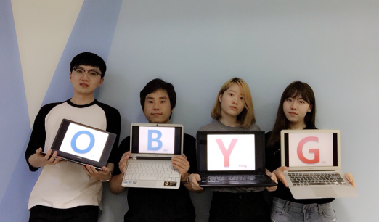
Q&A
THANK YOU

